Slide 1
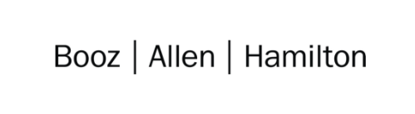

Cloud Excellence Presentation
Group 3
Universal Calculator
Members: Adeyeni Aromolaran, Jasper Choi, Arjun Raman, Ahmed Shahid
JULY 2021

Slide 2
TEAM <3>: A generally available calculator app
Our Official Project for the Booze Allen Cloud Excellence Program
www.webagesolutions.com|1.877.517.6540

Slide 3
Calculator Project
Introductions
Project Overview
Architecture/Design diagram
Tools/Software Environment used
Challenges/Issues/Problems/Your stories
What have you learned/learned?
What else can we do on the project? - future plan- any design and implementation ideas?
Demo
Questions and answers
www.webagesolutions.com|1.877.517.6540

Slide 4




INTRODUCTIONS TO OUR CALCULATOR TEAM
Adeyeni Aromolaran AWS Admin
Jasper Choi Scribe
Arjun Raman Speaker
Ahmed Shahid Utility Player

Slide 5
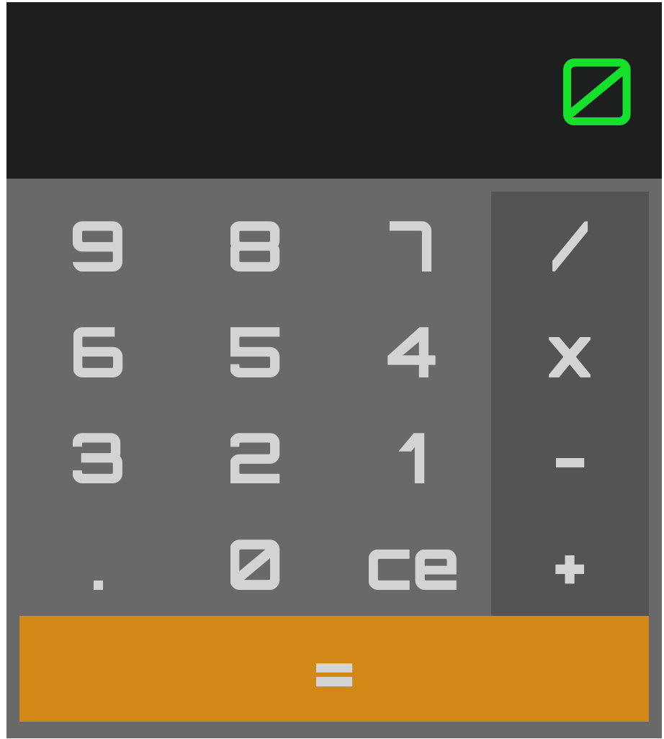
Project Overview & Requirements
Project Name: Our Colorful Calculator
Background:
Calculators are boring in color and they need to be made available to everyone – smartphone or not.
Ever click operators too fast - Sometimes you don’t click the write operator, or you hit that too soon. We need an easy way to see buttons the user is about to push
Technical Goals
Easy deployment pattern with easy source code management
Ability to deploy a static site
Lightweight code with future potential for functionality
Domain: https://master.d3nfu5srh82rlg.amplifyapp.com
Repo: https://github.com/uscjunie/react-calculator
Project Requirements - All projects must show a simple aspect of the following:
Infrastructure as code - this can be a YAML file, JSON, or something more developed. It must be checked into a repo and accessible by all team members. That repo is preferably available to instructors and others in at least a read capacity.
Automation - Use of automation, even if it is just a command line to start, but the use of Jenkins is preferred.
AWS Services - Use of AWS services in any way, shape, or form.
A Design - High-level component design + Call out to AWS services, flow, tools, etc.
Tools that you chose and were used - Keep a running list; Note any learnings as well, as they will help your presentation. Keep a journal.
Failures and Success - It is recommended that you keep a log of failures and success

Slide 6
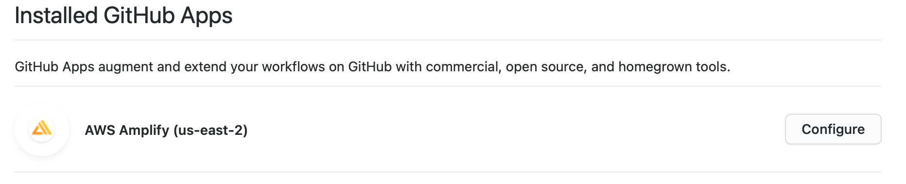
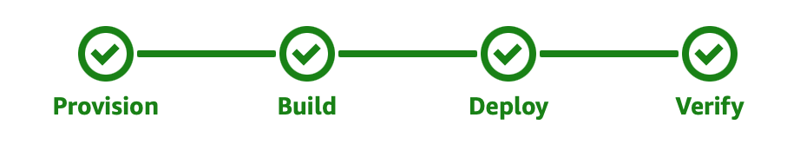
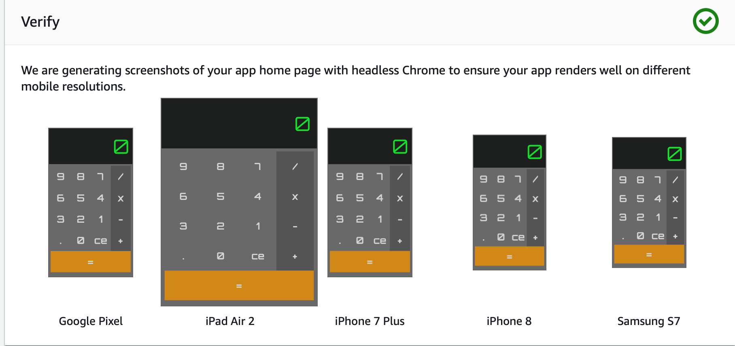
Technologies and Environment used
Source Code: Git with github.com (React.js codebase)
Authorization with Git Integrations (webhook)
Build Instructions: amplify.yml
AWS Amplify: Static Site Generation - full-stack applications builder with AWS resources. For our site, Amplify sets up a code pipeline with various stages:
Provision – USE2 – Container on a Standard Shared Amazon Linux base– 4 vCPU, 7GB of memory; Storage; Bandwidth – Developer does not control
Build + Deploy – Builds the code continuously and secures the deployment
Verify – by device type to see if its rendering properly
Other Resources:
CloudTrail
S3 Bucket (logs) – Simple Storage
CloudWatch
AWS Glue – integration services
AWS SNS – Webhook for build notification

Slide 7
Architecture and Design [Current State]

Slide 8
Challenges and Issues
Stories about your Project
-We brainstormed a lot as a team and read through a lot of documentation
-Balanced client work and life events (baby and wedding)
-Kept simplicity in mind
Issues
-We ran into an issue with our initial react app that only deployed a small portion of html code on the index.css, calculator app was not functioning properly due to lack of being fully built properly from our code base
-Did not have billing tracking so did it blind and documentation (e.g., Amplify pricing detail)
Challenges
-We had some trouble getting started and settling on an idea that can focus on infrastructure as code while fulfilling project requirements
-We had issues with npm vs. yarn packaging therefore used .yml
-Limited time on the team due to work and life commitments

Slide 9
What have we learned?
Do not overthink the code portion of the application: we ended up having to find another react code base that used the npm commands (file and packaging) ran better
AWS Amplify is a great resource to easily get started with full-stack (front end and back-end) continuous deployments. In our case we showcased the front-end by having Amplify host our application on a generated static site
Ensure that the amplify.yml has build commands that are consistent with the dependencies within the application’s code base and structured to meet AWS Amplify (as a resource).

Slide 10
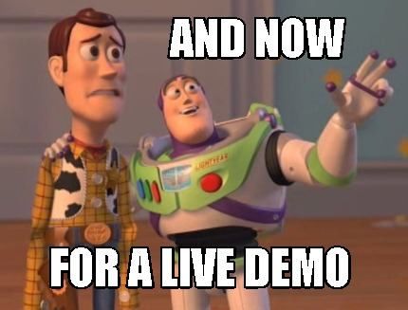
Demo

Slide 11
Future State - What we would add
AWS Secrets Manager – Store GitHub credentials / authorizations to avoid authorization webhook.
AWS CodeCommit – If this was used as our repo instead of GitHub, we can track/log the modifications made by each AWS user with more granularity all within using AWS resources. We’ll use this to deploy a back-end. Giving us two code pipelines joined together with back-end infrastructure.
Route 53 – Can add a custom domain via Route 53 instead of using the one provided by Amplify, if we don’t want our domain to be https://<branch-name>.d1m7bkiki6tdw1.amplifyapp.com
Back-end infrastructure - to save results of calculations to a DynamoDB table while using AWS API Gateway to connect our calculator app to a backend database to store results. AWS lambda facilitates certain interactions from API gateway and app.

Slide 12

Q & A - Ask us anything

Slide 13
Thank you!!!
JULY 2021

